Slide 1


Slide 2
Group 1
DWI Hardiyanto - 1901517516
GIAN KURNADI - 1901484865
IHSAN IBRAHIM PASHA - 1901495755
MERY ANGELYA - 1901460026
SHAFIA RISA ANANDA - 1901517926
STEFanus jemmy handira - 1901467764

Slide 3
Presentation outcome
Company profile
Database planning
System definition
Requirements Collection and Analysis
Database design
Query Database
User interface

Slide 4
Company profile

Slide 5

Business information
Business Name : CLOTHE & CLEAN
Business Address : Kemanggisan Street no.170,
West Jakarta
Email : clothenclean@gmail.Com
Tel : 021-6327688

Slide 6
Business information
General Business Activities
CLOTHE & CLEAN is established as a laundry service company in Kemanggisan Street of West Jakarta, Indonesia. Located at a densely populated and busy area, CLOTHE & CLEAN offers the assurance of fast, convenient, and professional laundry service. CLOTHE & CLEAN has different laundry service package options which are designed to best suit the customer’s needs. To ensure the service quality and professionalism, all the laundry operational transactions data are stored in a database specifically programmed to support the daily laundry service operations. All the products used in the laundry cleaning service are environmentally friendly products that efficiently clean every different type of fabric.

Slide 7
COMPANY STRATEGY
Purpose
To be a leader in the laundry business by providing convenient and enhanced laundry services.
Vision
To provide quality laundry services that exceeds the expectations of our esteemed customers.
Mission statement
To build long term relationships with our customers and provide exceptional customer services through innovation and professionalism.

Slide 8
COMPANY STRATEGY
Core values
We believe in treating our customers professionally with respect and faith.
We are eager to improve through our entire customer’s critics and advice.
We grow through creativity, innovation, and technology in our services.
We integrate honesty, integrity and business ethics into all aspects of our business services

Slide 9
goals
Regional expansion in the field of laundry service business.
Increase the assets of the company to support the development of services.
To build good reputation of laundry service business and maintain long-lasting relationship with our customers.

Slide 10
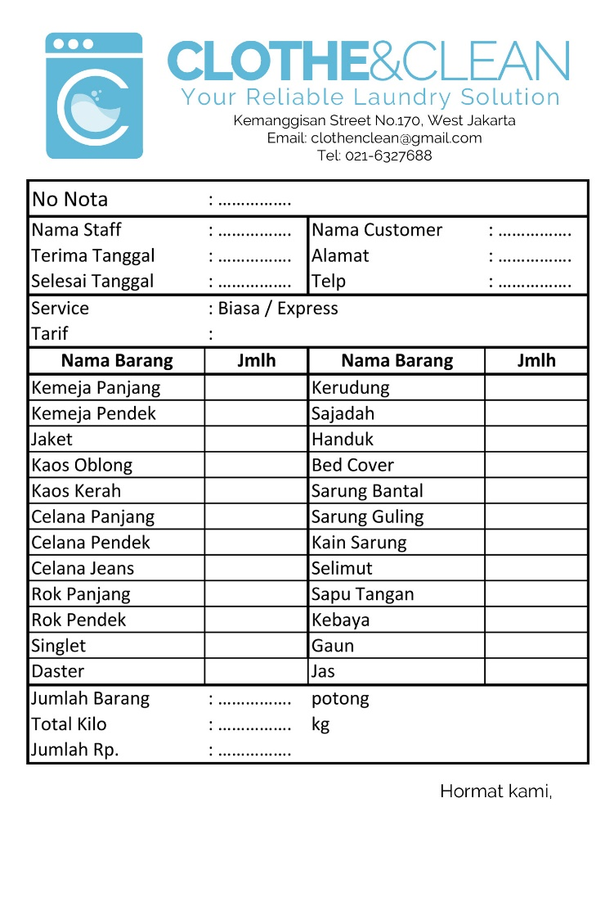
Laundry Service Receipt

Slide 11
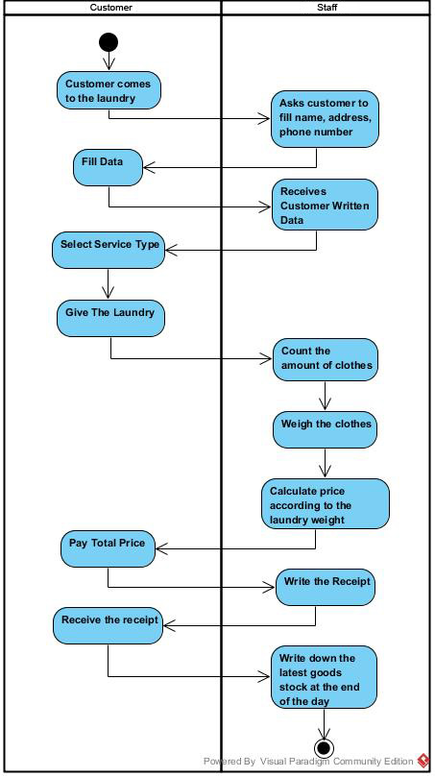
Business process WITHOUT SYSTEM

Slide 12
Database planning

Slide 13
Mission statements
The purpose of the clothe & clean database system is to maintain the data that is used and generated to support and facilitate the company with reliable and real time information.

Slide 14
Mission objectives
To maintain (enter, update, and delete) data on MsMember.
To maintain (enter, update, and delete) data on MsPakaian.
To maintain (enter, update, and delete) data on MsServiceType.
To maintain (enter, update, and delete) data on MsStaff.
To maintain (enter, update, and delete) data on MsStock.
To maintain (enter, update, and delete) data on MsSupplier.
To display MsMember.
To display MsPakaian.
To display MsServiceType.
To display MsStaff.
To display MsStock.
To display MsSupplier.
To generate sales report.
To generate purchases report.

Slide 15
Documentation Needed to Support The Database
Laundry service receipt
Registration form
Stock purchase order

Slide 16
Data Recorded to The Database
Member data
Staff data
Clothes data
Service type data
Stock data
Supplier data

Slide 17
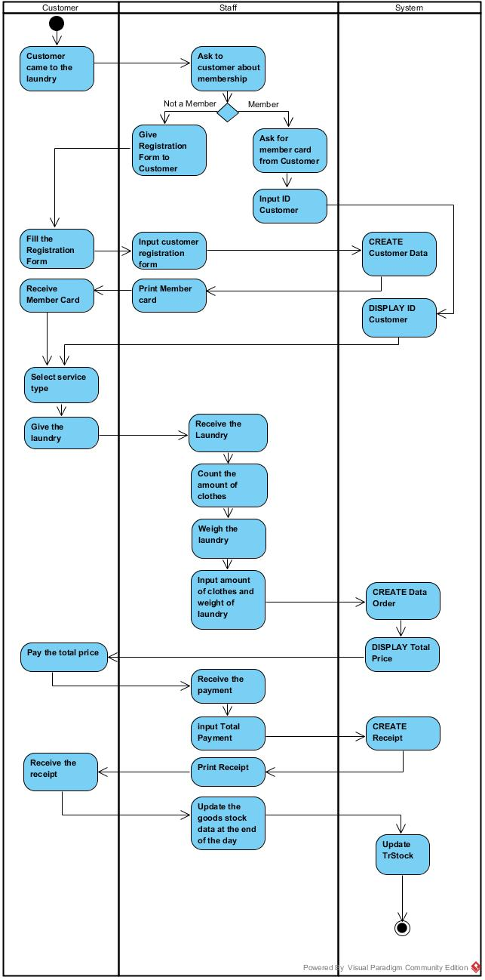
Business process WITH SYSTEM

Slide 18
System definition

Slide 19
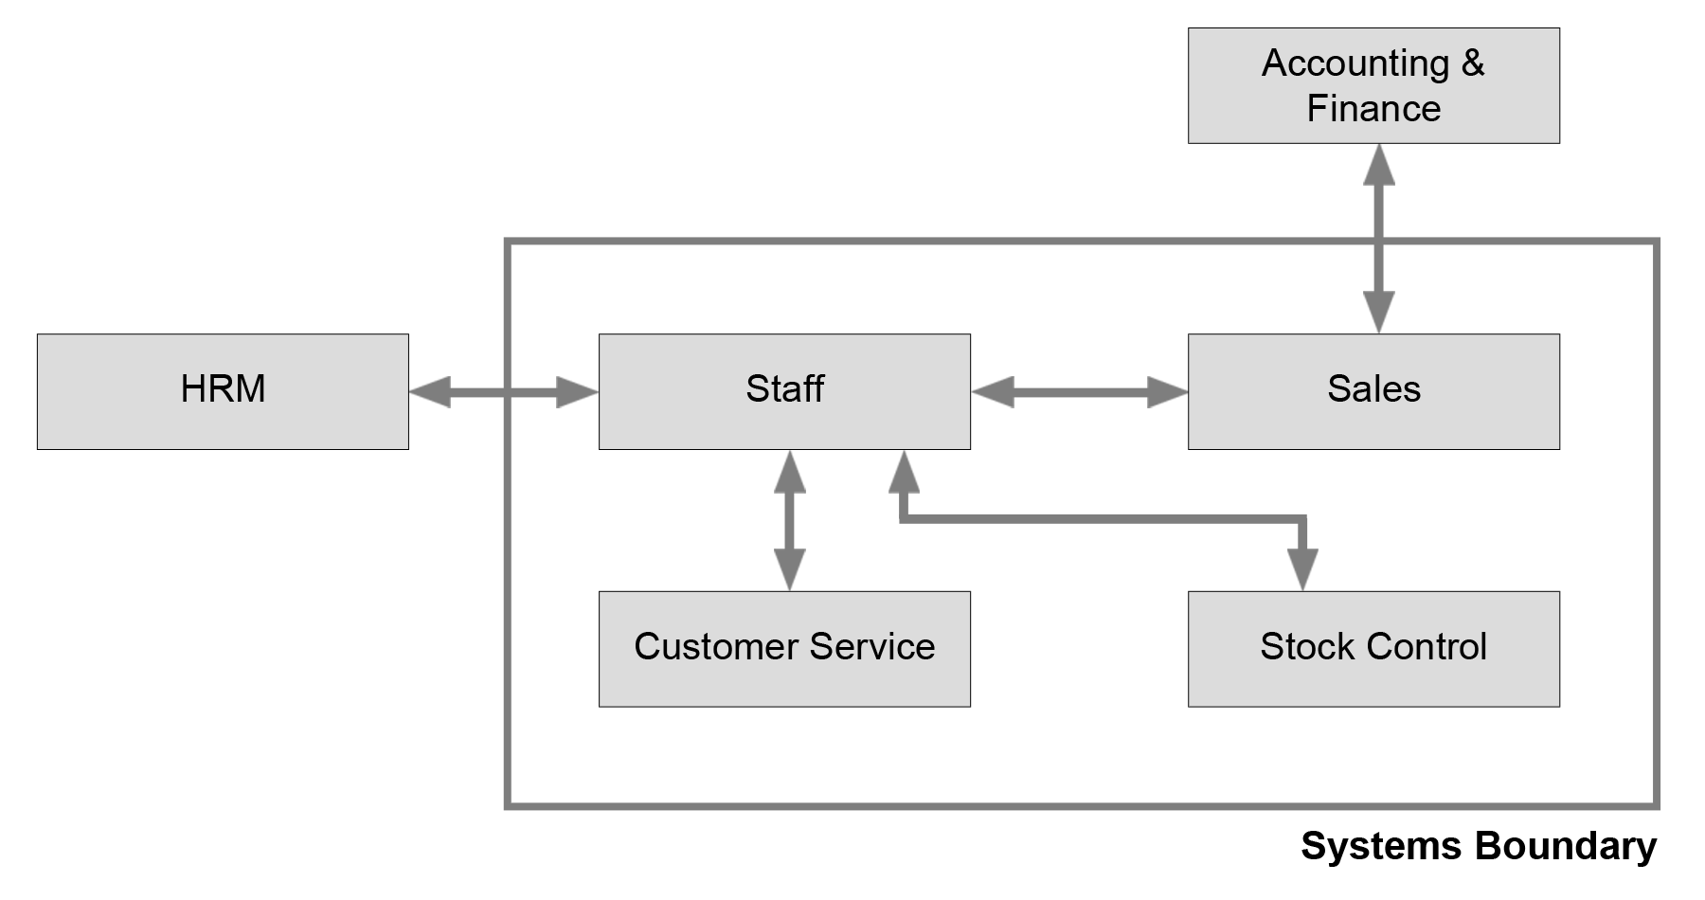
System boundary

Slide 20
Requirements collection and analysis

Slide 21
Centralized Approach
The approach that is used for the database’s requirement collection and analysis is centralized approach. All the requirements for each user view are merged into a single list of requirements for the C&C laundry’s database system. During the database design stage, a logical data model representing all user views is created. Basically, we collate the requirements for different user views into a single list of requirements. Then, a data model representing all user views is created in the database design stage.

Slide 22
Cross-reference of User Views with the Main Types of Data Used by Each
 | Member | Staff | Owner
TrLaundry | ✓ | ✓ | ✓
MsMember | ✓ | ✓ | ✓
MsPakaian | ✓ | ✓ | ✓
TrLaundryDetail |  | ✓ | ✓
MsServiceType | ✓ | ✓ | ✓
MsStaff |  | ✓ | ✓
MsStock |  | ✓ | ✓
TrStock |  | ✓ | ✓
MsSupplier |  | ✓ | ✓

Slide 23
Major User Views
Data | Access Type | Member | Staff | Owner
 | Maintain |  | X
TrLaundry | Query | X | X | X
 | Report |  | X | X
 | Maintain |  | X
MsMember | Query | X | X | X
 | Report |  | X | X
 | Maintain |  | X
MsPakaian | Query | X | X | X
 | Report |  |  | X
 | Maintain |  | X
TrLaundryDetail | Query |  | X | X
 | Report |  |  | X
 | Maintain |  |  | X
MsServiceType | Query | X | X | X
 | Report |  |  | X
 | Maintain |  | X | X
MsStaff | Query |  | X | X
 | Report |  | X | X
 | Maintain |  | X
MsStock | Query |  | X | X
 | Report |  | X | X
 | Maintain |  | X
TrStock | Query |  | X | X
 | Report |  | X | X
 | Maintain |  |  | X
MsSupplier | Query |  | X | X
 | Report |  |  | X

Slide 24
Database design

Slide 25
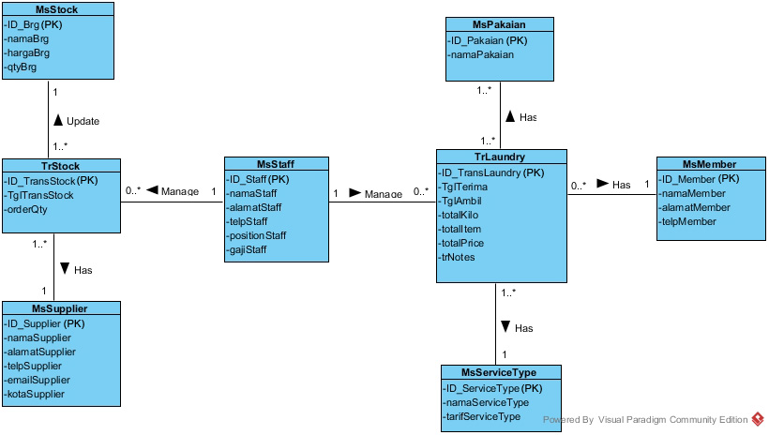
conceptual database design

Slide 26
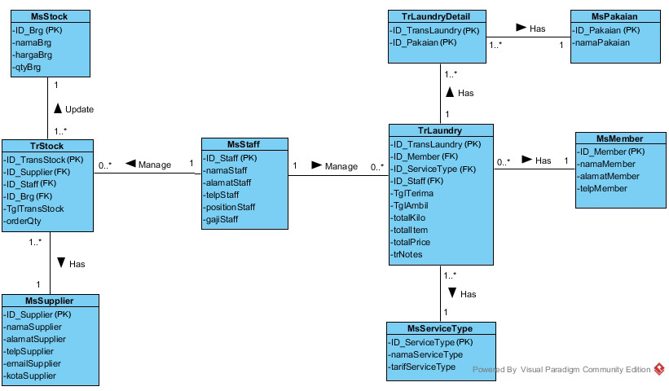
Logical er modeling

Slide 27
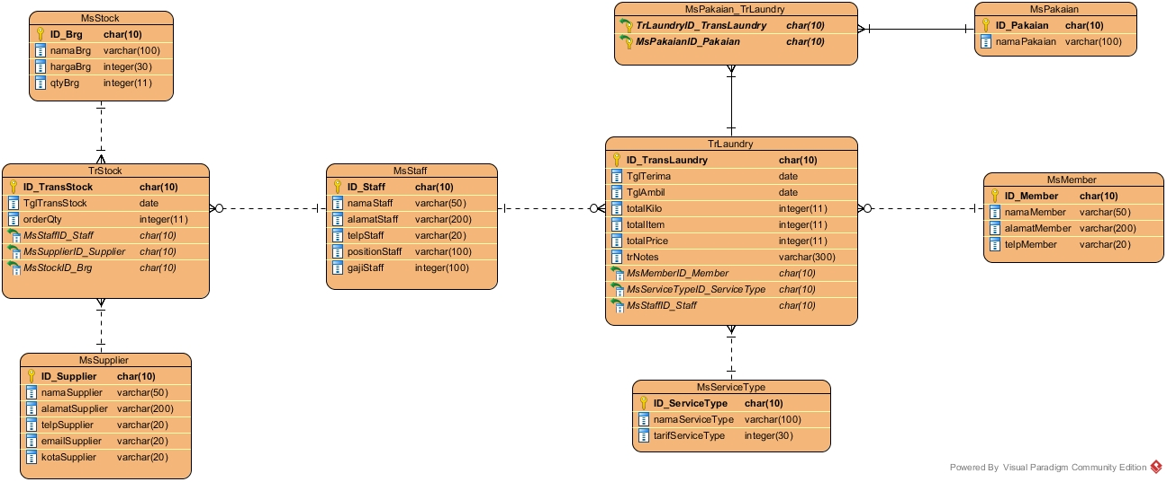
Physical database design

Slide 28
Cross-Referencing Transactions and Relations
Transaction/ Relation | View Transaction |  |  |  | Manage Member |  |  |  | Manage Staff |  |  |  | Manage Supplier
 | I | R | U | D | I | R | U | D | I | R | U | D | I | R | U | D
TrLaundry |  | ●
MsMember |  |  |  |  |  | ● | ● | ●
MsServiceType
TrLaundryDetail
MsPakaian
MsStaff |  |  |  |  |  |  |  |  | ● | ● | ● | ● | ● | ● | ● | ●
TrStock
MsSupplier
MsStock
Transaction/ Relation | Data Stock |  |  |  | Register Member |  |  |  | Order Laundry |  |  |  | Update Stock
 | I | R | U | D | I | R | U | D | I | R | U | D | I | R | U | D
TrLaundry |  |  |  |  |  |  |  |  | ●
MsMember |  |  |  |  | ● |  |  |  |  | ●
MsServiceType |  |  |  |  |  |  |  |  |  | ●
TrLaundryDetail |  |  |  |  |  |  |  |  | ●
MsPakaian |  |  |  |  |  |  |  |  |  | ●
MsStaff |  |  |  |  |  |  |  |  |  | ●
TrStock |  |  |  |  |  |  |  |  |  |  |  |  | ● | ● | ● | ●
MsSupplier |  | ● |  |  |  |  |  |  |  |  |  |  |  | ●
MsStock |  | ● | ●

Slide 29
Cross Referencing of Role
Transaction/ Relation | Member |  |  |  | Staff |  |  |  | Owner
 | I | R | U | D | I | R | U | D | I | R | U | D
TrLaundry | ● | ● |  |  | ● | ● | ● | ● | ● | ● | ● | ●
MsMember | ● | ● |  |  | ● | ● | ● | ● | ● | ● | ● | ●
MsServiceType |  | ● |  |  | ● | ● | ● | ● | ● | ● | ● | ●
TrLaundryDetail |  | ● |  |  | ● | ● | ● | ● | ● | ● | ● | ●
MsPakaian |  | ● |  |  | ● | ● | ● | ● | ● | ● | ● | ●
MsStaff |  | ● |  |  | ● | ● | ● | ● | ● | ● | ● | ●
TrStock |  |  |  |  | ● | ● | ● | ● | ● | ● | ● | ●
MsSupplier |  |  |  |  | ● | ● | ● | ● | ● | ● | ● | ●
MsStock |  |  |  |  | ● | ● | ● | ● | ● | ● | ● | ●

Slide 30
normalization
UNF
TrLaundry | (ID_TransLaundy, namaStaff, TglTerima, TglAmbil, namaMember, alamatMember, telpMember, namaServiceType, tarifServiceType, {namaPakaian}, totalItem, totalKilo, totalPrice, trNotes)
1NF
TrLaundry | (ID_TransLaundy, namaStaff, TglTerima, TglAmbil, namaMember, alamatMember, telpMember, namaServiceType, tarifServiceType, totalItem, totalKilo, totalPrice, trNotes)
TrLaundryDetail | (ID_TransLaundry, ID_Pakaian, namaPakaian)
2NF
TrLaundry | (ID_TransLaundy, namaStaff, TglTerima, TglAmbil, namaMember, alamatMember, telpMember, namaServiceType, tarifServiceType, totalItem, totalKilo, totalPrice, trNotes)
TrLaundryDetail | (ID_TransLaundry, ID_Pakaian)
MsPakaian | (ID_Pakaian, namaPakaian)
3NF
TrLaundry | (ID_TransLaundy, ID_Staff, ID_Member, ID_ServiceType, TglTerima, TglAmbil, totalItem, totalKilo, totalPrice, trNotes)
TrLaundryDetail | (ID_TransLaundry, ID_Pakaian)
MsPakaian | (ID_Pakaian, namaPakaian)
MsMember | (ID_Member, namaMember, alamatMember, telpMember)
MsStaff | (ID_Staff, namaStaff, alamatStaff, telpStaff, positionStaff, gajiStaff)
MsServiceType | (ID_ServiceType, namaServiceType, tarifServiceType)
From Laundry Service Receipts

Slide 31
normalization
UNF
TrStock | (ID_TransStock, TglTransStock, namaSupplier, namaStaff, namaBrg, totalHarga, orderQty)
1NF
TrStock | (ID_TransStock, TglTransStock, namaSupplier, namaStaff, namaBrg, orderQty)
2NF
TrStock | (ID_TransStock, TglTransStock, namaSupplier, namaStaff, namaBrg, orderQty)
3NF
TrStock | (ID_TransStock, ID_Supplier, ID_Staff, ID_Brg, TglTransStock, orderQty)
MsStaff | (ID_Staff, namaStaff, alamatStaff, telpStaff, positionStaff, gajiStaff)
MsBarang | (ID_Brg, namaBrg, hargaBrg, qtyBrg)
MsSupplier | (ID_Supplier, namaSupplier, alamatSupplier, telpSupplier, emailSupplier, kotaSupplier)
From Stock Purchase Orders

Slide 32
Normalization
3NF from both Laundry Service Receipts and Stock Purchase Orders
3NF
TrLaundry | (ID_TransLaundy, ID_Staff, ID_Member, ID_ServiceType, TglTerima, TglAmbil, totalItem, totalKilo, totalPrice, trNotes)
TrLaundryDetail | (ID_TransLaundry, ID_Pakaian)
MsPakaian | (ID_Pakaian, namaPakaian)
MsMember | (ID_Member, namaMember, alamatMember, telpMember)
MsStaff | (ID_Staff, namaStaff, alamatStaff, telpStaff, positionStaff, gajiStaff)
MsServiceType | (ID_ServiceType, namaServiceType, tarifServiceType)
TrStock | (ID_TransStock, ID_Supplier, ID_Staff, ID_Brg, TglTransStock, orderQty)
MsBarang | (ID_Brg, namaBrg, hargaBrg, qtyBrg)
MsSupplier | (ID_Supplier, namaSupplier, alamatSupplier, telpSupplier, emailSupplier, kotaSupplier)

Slide 33
User interface

Slide 34
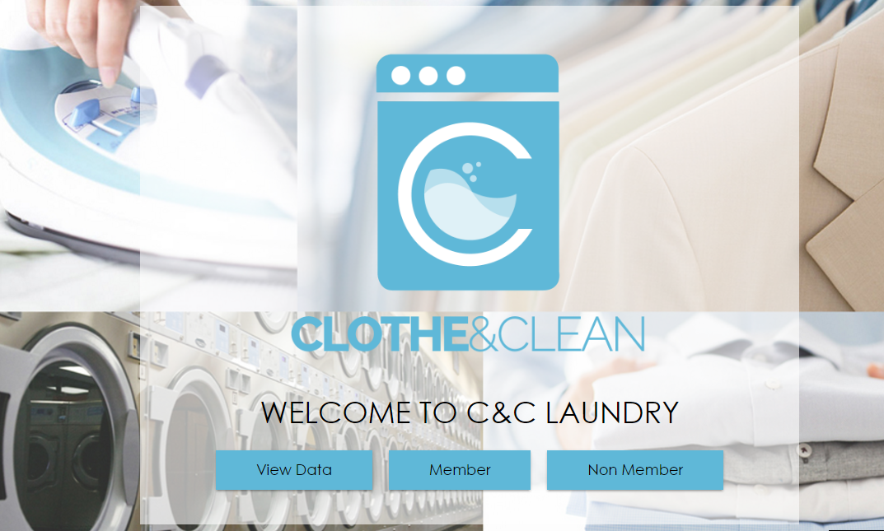

Slide 35
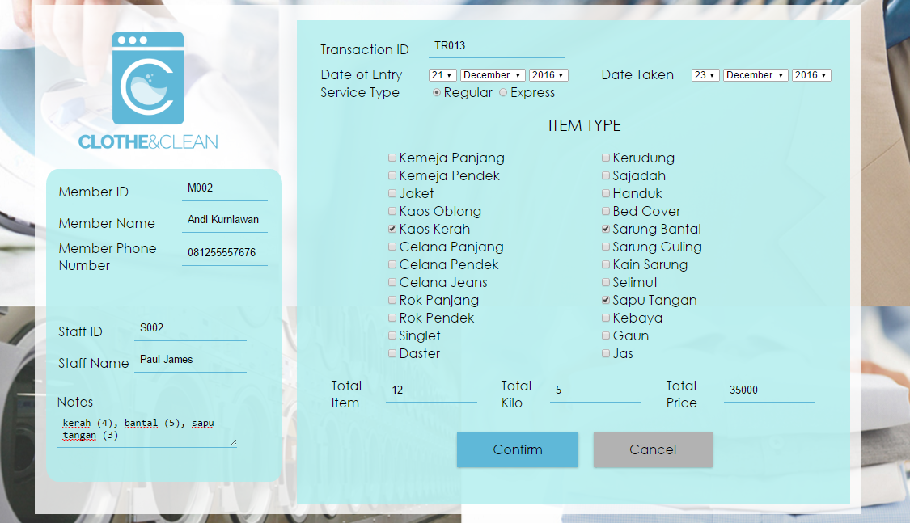

Slide 36
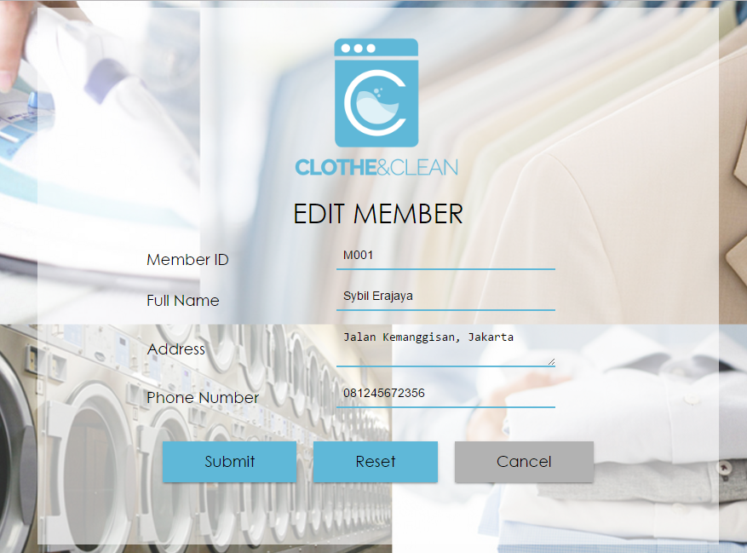

Slide 37
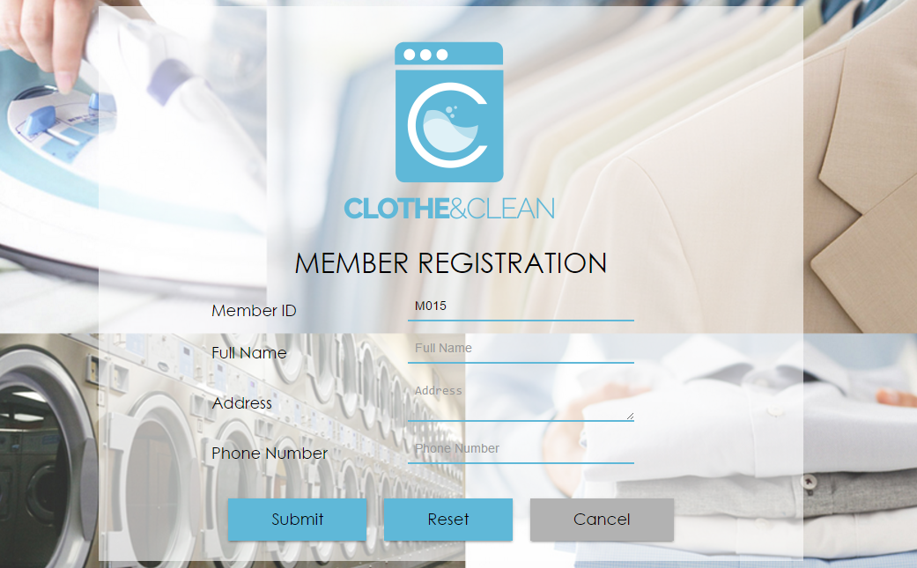

Slide 38
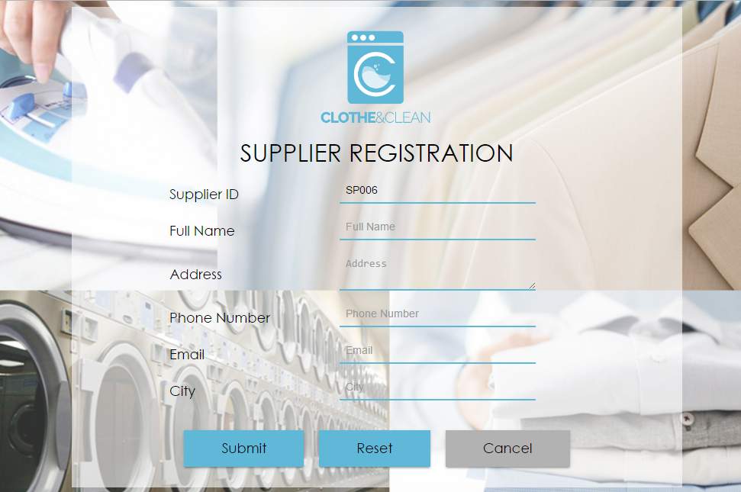

Slide 39
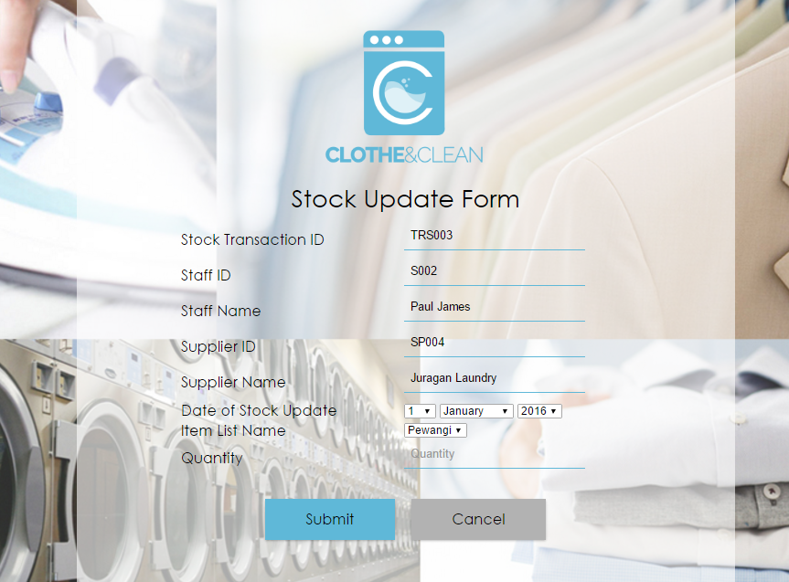

Slide 40
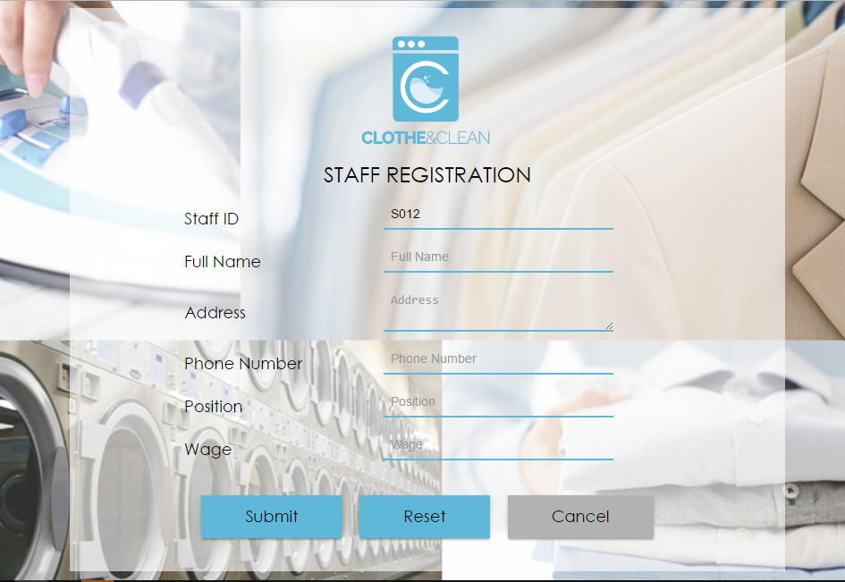

Slide 41
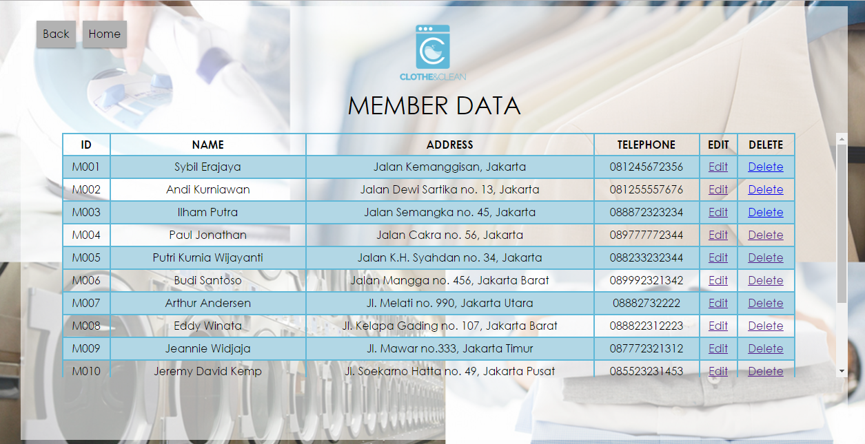

Slide 42
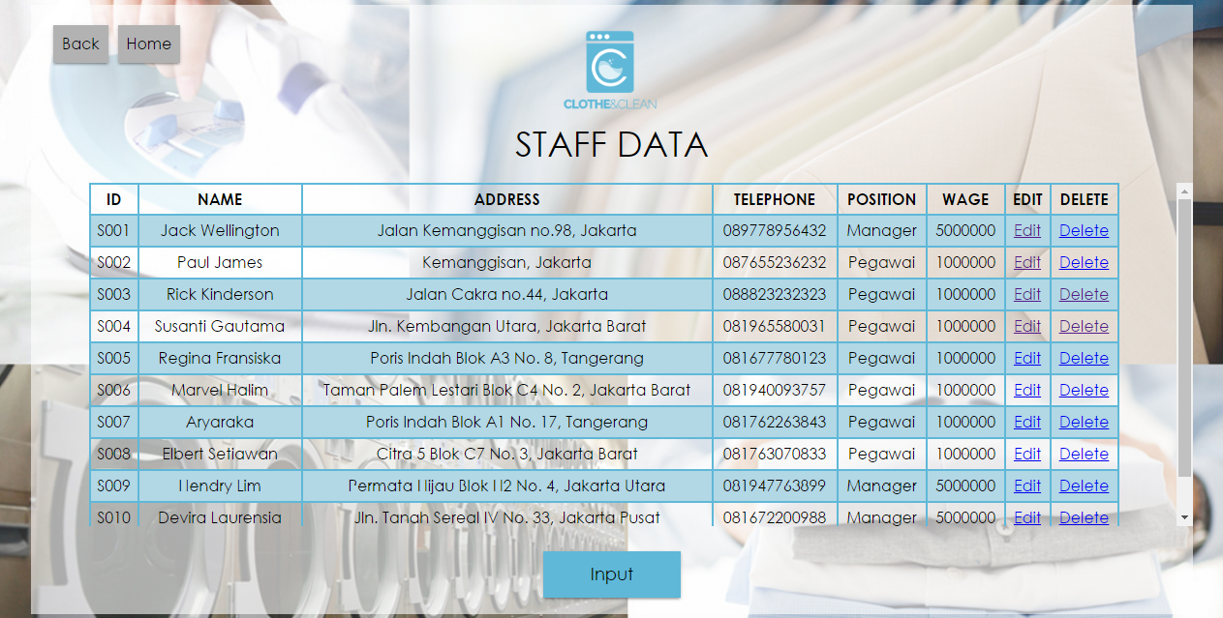

Slide 43
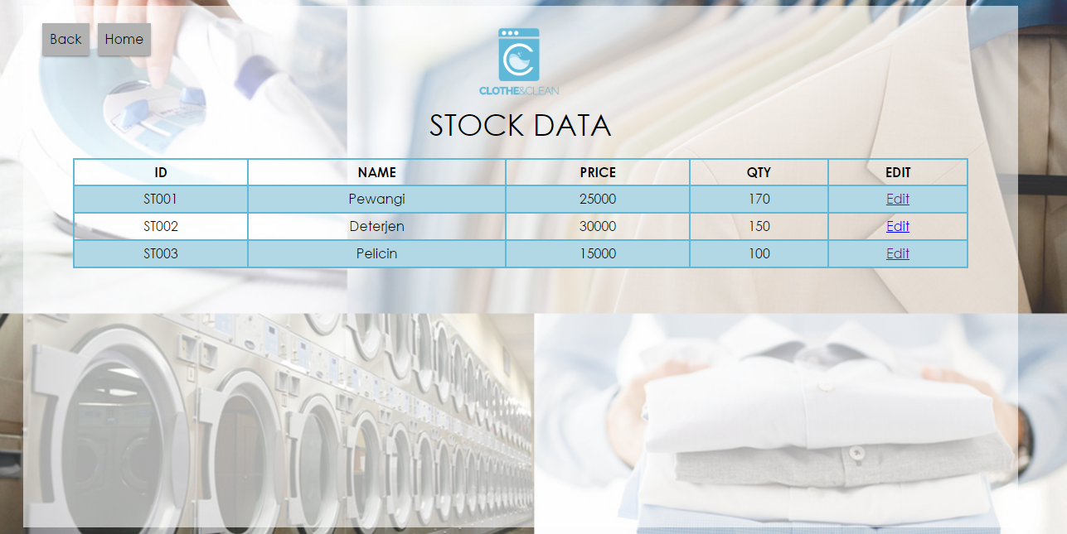

Slide 44
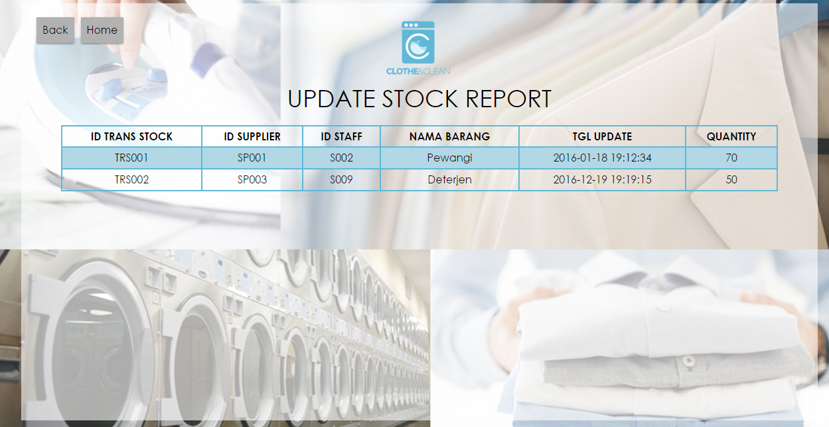

Slide 45
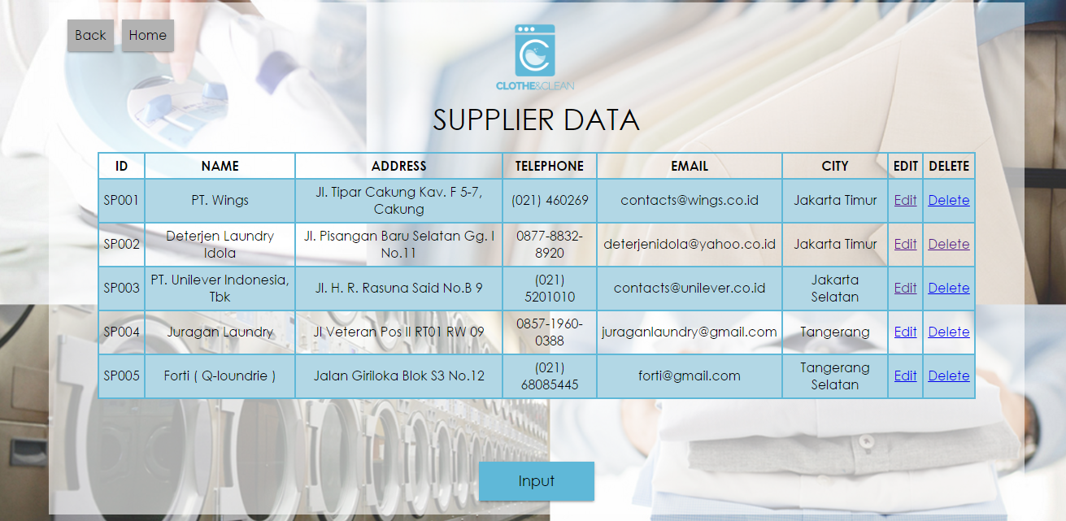

Slide 46
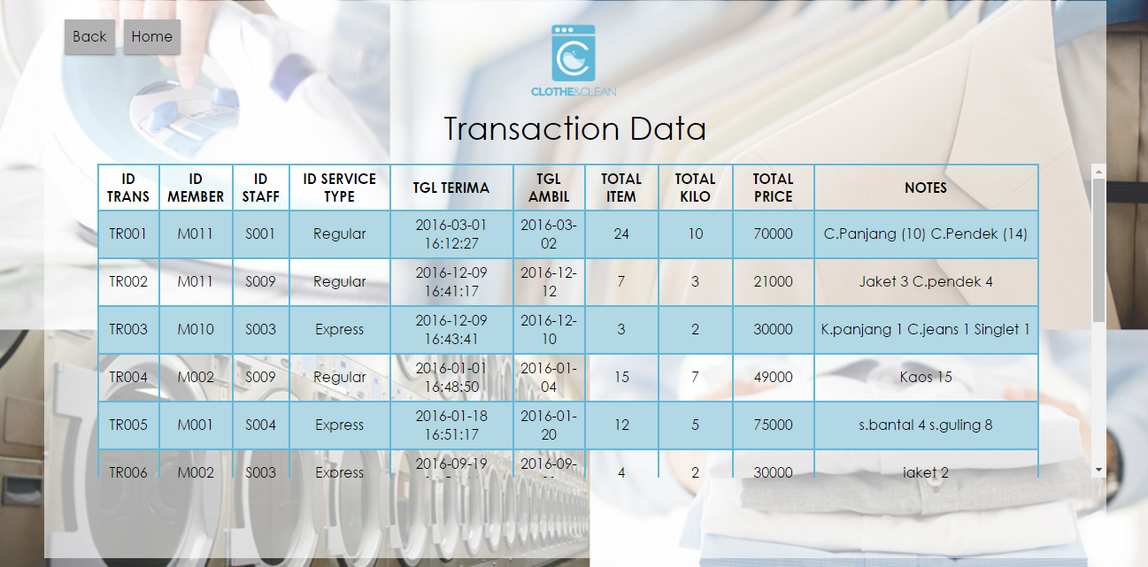

Slide 47
Thank you

